Slide 2
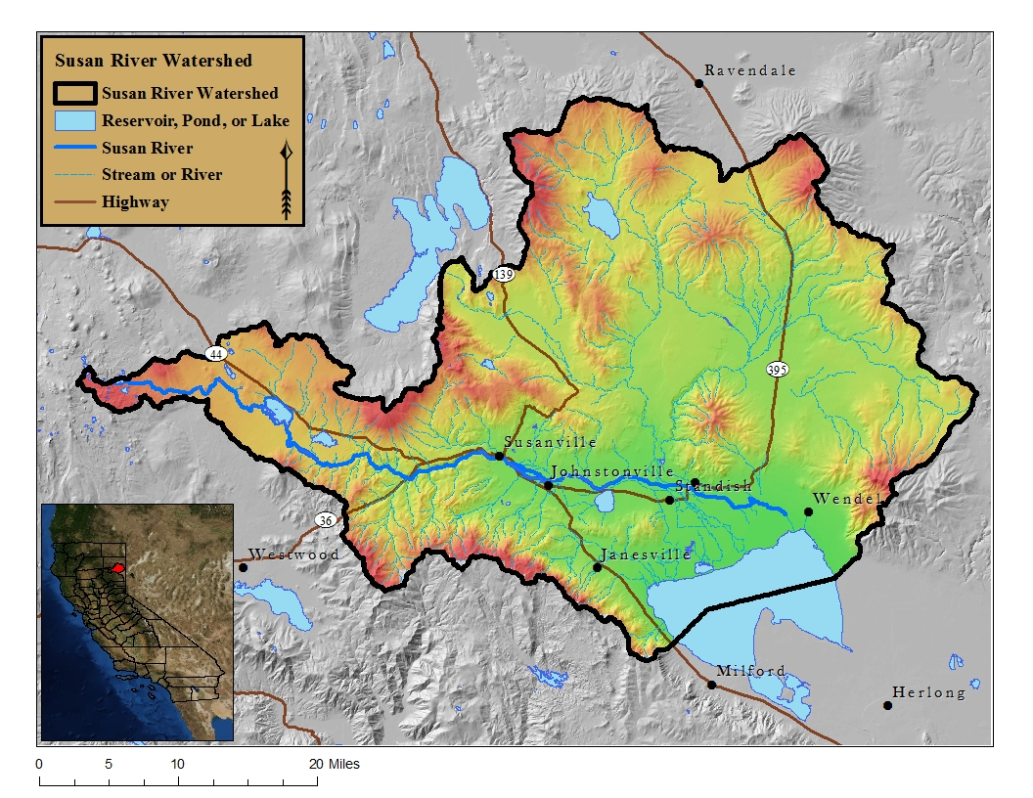

Slide 3
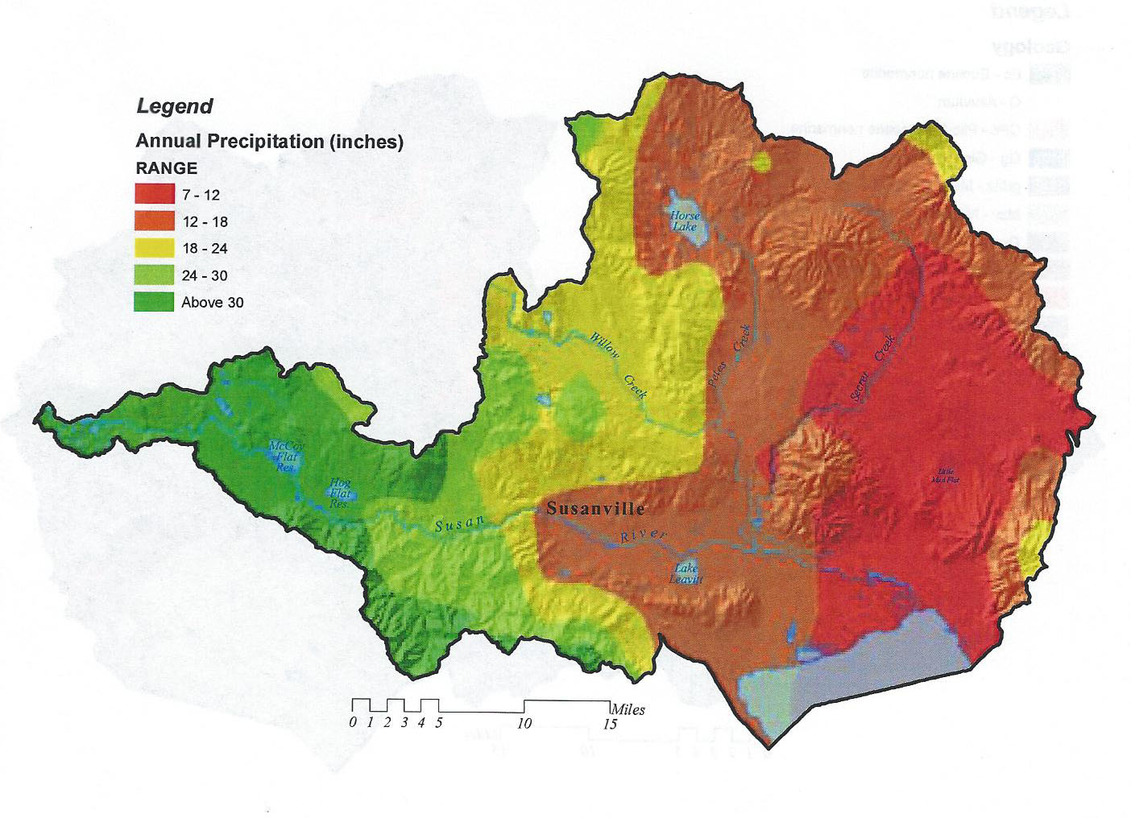
Susan River Watershed
Located in northeastern California - Lassen County.
Drains approximately 748,875 acres, or 1170 square miles of land;
Ranges in elevation from 7000 feet above sea level at the headwaters and 4000 feet in the Honey Lake Valley on the east end of the project.
Precipitation ranges widely with elevation, higher elevations receive over 45 inches of precipitation per year in the Caribou Wilderness on the west end of the watershed, mainly in the form of winter snowfall. In contrast, the alluvial valleys (such as along the mainstream Susan River) are more arid, receiving 7-12 inches of precipitation per year mainly as rain and rapidly melting snow.
Agricultural land, timber, rangeland, and fish and wildlife habitat are highly valuable resources within the Susan River Watershed.

Slide 4
Susan River Watershed
Encompasses four ecological provinces including the Basin and Range Province to the east, , the granitic Sierra Nevada Range to the southwest, and the volcanics of the Modoc Plateau and the Cascade Range to the north and west
Characterized by juniper and mixed conifer forests, rugged mountains, and broad valleys containing significant wetlands and irrigated farmland.
There are five major tributaries of the Susan River Watershed: Paiute Creek, Gold Run Creek, Lassen Creek, Willow Creek, and Baxter Creek. Baxter Creek does not enter the Susan River, but adds to the water budget of and therefore is considered part of the Susan River Watershed.

Slide 5
Susan River Watershed

Slide 6
Upper Susan River Watershed
The U.S. Forest Service, Bureau of Land Management (BLM), and private industrial timber companies own and manage most of the upper elevation timber and range lands.
Land Ownership within the Susan River Watershed (NRCS 2011)

Slide 7
Lower Susan River Watershed
Mainly privately owned and used for ranching and farming.
Residential use occurs in and around the communities of Susanville, Janesville, Johnstonville, Standish and Litchfield.
Agricultural crops consist of alfalfa hay, wild rice, oats, barley, wheat, and irrigated and non-irrigated pasture for grazing. Cattle ranching and alfalfa production are among the highest grossing agricultural products.

Slide 8
Susan River
Susan River is the major river draining the Honey Lake Valley, which is approximately 2,375 square miles in area.
The Susan River and its numerous tributaries flow over 40 river miles .
The Susan River is a perennial stream originating from Silver and Caribou Lakes in northwest Lassen County, California and flowing easterly through McCoy Reservoirs and the City of Susanville, ultimately discharging into Honey Lake.
The Susan River has a steeper gradient in its upper reaches west of Susanville, but from Susanville to Honey Lake its gradient is greatly reduced. This change is reflected in the river bottom materials, which are characteristically gravels, cobbles and boulders upstream from Susanville, while substrates downstream are usually small gravels, sands, and silts.

Slide 9
Susan River Watershed Group: Mission Statement
The mission of the Susan River Watershed Group (SRWG) is to foster partnerships that collaborate to develop and implement a Watershed Management Plan (WMP) to achieve integrated long-term cultural, economic, and environmental health of the watershed through active community participation.
Susan River leaving McCoy Flat

Slide 10
Susan River Watershed Group PARTNERS
The following partners have signed a Memorandum of Understanding (MOU) Regarding the Development of the Susan River Watershed Management Plan:
Honey Lake Valley RCD
Lassen National Forest
Bureau of Land Management, Eagle Lake Field Office
Lassen Land and Trails Trust
Lassen County Board of Supervisors
City of Susanville
Lassen Irrigation Company
Susanville Indian Rancheria
California Department of Transportation
California Department of Fish and Game
University of California, Cooperative Extension, Lassen County
Lassen County Cattlemen’s Association
Natural Resource Conservation Service (NRCS)
Pheasants Forever
Lassen County Farm Bureau
Sierra Pacific Industries
W.M. Beaty and Associates, Inc.
North Cal Neva RC&D
Private Landowners with Large Landholding within the SRW

Slide 11
Susan River Watershed Management Strategy LIST OF CONTRIBUTORS
This Watershed Management Strategy is financially supported with funding the Honey Lake Valley Resource Conservation District (RCD) obtained from:
the CA Department of Conservation (DOC), Division of Land Resource Protection (DLRP), Statewide Watershed Program Watershed Coordinator Grants funded through the Safe Drinking Water, Water Quality and Supply, Flood Control, River and Coastal Protection Act of 2006 (Proposition 84), and;
USDA Forest Service through Title II of the Secure Rural Schools Act (SRSA) and the Lassen County Resource Advisory Committee.

Slide 12
Susan River Watershed Management Strategy Introduction
This Susan River Watershed Management Strategy describes management challenges in the Susan River Watershed and identifies strategies to address those challenges. The Management Strategy was developed based on stakeholder input and other existing information.
Susan River

Slide 13
Susan River Watershed Management Strategy Introduction
The purpose of the management strategy is to:
Identify principal issues and concerns and align interests in the Susan River so that consensus can be reached regarding appropriate watershed and land management actions.
Define actions needed to address conditions that are currently limiting or threatening the watershed health;
Facilitate a better understanding of causes that are limiting or threatening desired watershed conditions;
Identify lead stakeholders for implementing management actions
Provide a framework for periodic evaluation of management results, reformulation of management approaches, and identification of new watershed management issues
Support the maintenance and improvement of desired landscape conditions in the watershed, e.g. sustainable agricultural operations, open space, quality wildlife habitat.

Slide 14
Susan River Watershed Management Strategy Introduction
Emphasis is placed on opportunities to modify stream channel and landscape conditions to benefit water quality, aquatic habitat, wildlife habitat, range and forest health. Social and economic factors are also considered in the development of the management strategy.
Support from stakeholders is crucial to the success of this project,.
The Watershed Management Strategy describes the existing conditions, discusses the primary issues and concerns, and provides management recommendations for projects and other actions to address those concerns.
Brockman Slough

Slide 15
Susan River Watershed Management Strategy Goals
Increase Summer Base Flow While Sustaining and Improving Groundwater Resources.
Improve Water Quality in the Susan River and Tributary Streams.
Reduce River and Stream Channel Erosion
Sustain/Improve Aquatic, Riparian, and Wetland Communities
Sustain and Improve Upland Vegetation and Wildlife Communities
Control and Prevent the Spread of Invasive Species and Noxious Weeds
Support and Encourage Better Coordination of Data Collection, Sharing, and Reporting in the Watershed
Support Community Sustainability by Strengthening Natural Resource Based Economies
Strengthen Community Watershed Stewardship in the Susan River Watershed
Investigate and prepare for the Potential Effects of Climate Change on the Watershed

Slide 16
Susan River Watershed Management Strategy Goal #1: Increase Summer Base Flow While Sustaining and Improving Groundwater Resources.
Existing Conditions and Assessment Conclusions:
Seasonal low flows in the Susan River and its numerous tributary streams cause adverse impacts to aquatic life, water dependent aquatic habitat, recreational use, and water quality.
Low flows impact agricultural operations when water is not available to divert for irrigation needs.
Degraded watershed conditions (e.g. entrenched stream channels, denser forest vegetation) have reduced the landscapes ability to “store” water during the wet season and “release” this water during the dry season.
Reduced water supply is greatest when irrigation needs are highest resulting in the use of groundwater resources to augment surface supplies.
Low summer flows in Baxter Creek

Slide 17
Susan River Watershed Management Strategy Goal #1: Increase Summer Base Flow While Sustaining and Improving Groundwater Resources.
Management Strategy:
Management Objective #1: Improve irrigation efficiency
Management Actions:
Promote the use of efficient irrigation techniques and assist landowners that seek financial help to implement those techniques.
Implement projects that demonstrate new and innovative solutions for flashboard dam operation that result in more consistent and sustained base flow in the Susan River.
Management Objective #2: Support the development of water storage that can be used to increase summer base flow and act as flood control.
Management Actions:
Support the continued development of a Groundwater Management Plan for the Susan River Watershed.
Support reconnaissance study on potential reservoir storage sites throughout the Upper Susan River watershed.
Dill slough diversion

Slide 18
Susan River Watershed Management Strategy Goal #1: Increase Summer Base Flow While Sustaining and Improving Groundwater Resources.
Management Objective #3: Where opportunities arise, help facilitate transfer of existing water rights to dedication for instream flow.
Management Actions:
Provide information to the watershed community on programs and opportunities for transfer, and possibly sale, of existing water rights for use as instream flow.
Management Objective #4 : Improve overall watershed condition (forest and meadow) to improve wet season storage and dry season water release
Management Actions:
See Goals #4 and #9 for discussion of management action to implement this objective.
Colony dam at the confluence of the Susan River and Willow Creek.

Slide 19
Susan River Watershed Management Strategy Goal #2: Improve Water Quality in the Susan River and Tributary Streams.
Existing Conditions and Assessment Conclusions:
Several water quality constituents are considered to be stressful or limiting to aquatic life in the Susan River and some reaches of tributary streams.
Constituents include temperature, dissolved oxygen, sediment concentrations, and nutrients.
Per section 303(d) of the Clean Water Act, the Susan River is listed as impaired for mercury.
Low flow in Baxter Creek creates poor water quality conditions.

Slide 20
Susan River Watershed Management Strategy Goal #2: Improve Water Quality in the Susan River and Tributary Streams.
Management Strategy:
Management Objective #1: Improve water temperature, dissolved oxygen, sediment, nutrient loads, and bacteria conditions throughout the Watershed.
Management Actions:
Solicit willing landowners and secure public and private funding assistance for projects that benefit water quality.
Address water quality concerns with irrigation water discharge and livestock management and implement a program that promotes and rewards good management practices at the individual ranch and farm level.
Management Objective #2: Eliminate or modify the existing 303(d) listing for the Susan River
Management Actions:
Establish a working group to address questions regarding listing.
Management Objective #3: Implement a Long-Term Water Quality Monitoring Program at Selected Watershed Locations.
Management Actions:
Establish and implement a monitoring program at strategic locations on the Susan River to track long-term trends and changes in water quality conditions.
Periodically conduct watershed-wide monitoring to provide more comprehensive information on water quality conditions in the watershed.

Slide 21
Susan River Watershed Management Strategy Goal #3: Reduce River and Stream Channel Erosion.
Existing Conditions:
Channel incisement or “entrenchment”
Flow is contained within the channel resulting in greater erosive force.
Erosive force creates vertical streambanks with exposed, bare soil which erodes during the entire year.
Factors responsible include: poor bridge and culvert design; heavy livestock grazing; diversion structures that do not consider hydrologic impacts; and past channel alterations.

Slide 22
Susan River Watershed Management Strategy Goal #3: Reduce River and Stream Channel Erosion.
Management Strategy
Management Objective 1: Restore and Sustain River/Stream Channels and Floodplain Function
Management Actions:
Identify river and stream channels and floodplains that have restoration potential.
Prioritize river and stream channels for restoration
Promote landowner and land manager meetings to discuss restoration opportunities.
Promote regional and state investment in public and private land restoration.
Promote and expand partnerships to accomplish restoration.
Secure funding to design, permit, and implement projects.
Management Objective 2: Stabilize River and Stream Channels that cannot be Restored in Order to Minimize Erosion.
Management Actions:
Identify river and stream channels and floodplains that have stabilization potential.
Prioritize river and stream channels for stabilization.
Secure funding to design, permit, and implement projects.
During the summer months, the deepened channel essentially “drains” the shallow groundwater from adjacent meadow.

Slide 23
Susan River Watershed Management Strategy Goal #3: Reduce River and Stream Channel Erosion.
Management Objective #3: Redesign Roads and Culverts to Prevent Artificial Concentrations of Flood Flows
Management Actions:
Identify existing bridge and culverts that are contributing to channel instability and degradation.
Prioritize bridge and culvert locations for new designs and implementation.
Promote the latest concepts in properly designed bridges and roads to the state for adoption into their design standards.
Establish relationships with Caltrans and County road departments responsible for new culvert and bridge designs.
Management Objective #4: Develop Sustainable Management Practices for Landowners Managing Streams/Rivers and Floodplains.
Management Actions:
Increase awareness about stream/river and floodplain form and function.
Develop and promote Sustainable Management Practices Program
Promote programs that protect and enhance riparian vegetation development.

Slide 24
Susan River Watershed Management Strategy Goal #4: Sustain/Improve Aquatic, Riparian, and Wetland Communities.
Existing Conditions and Assessment Conclusions:
Susan River contains a diverse range of aquatic habitats, supporting unique natural faunas, which include a number of federally and state recognized endangered, threatened or at-risk species.
Alteration of aquatic, riparian, and wetland habitat through past land and resource management activities has altered the natural functioning of the Susan River and its tributaries.
Impacts to aquatic and neigboring terrestrial communities, as well as increasing erosion, exacerbating bank loss, and drying up once moist fields, waterfowl attractions, and grazing lands.

Slide 25
Susan River Watershed Management Strategy Goal #4: Sustain/Improve Aquatic, Riparian, and Wetland Communities.
Management Strategy
Management Objective #1: Sustain and Improve Native Aquatic Communities to Maintain Ecosystem Roles and Prevent Regulatory Actions
Management Actions
Maintain appropriate connectivity between populations.
Ensure passage of migratory fish
Reduce the unintentional “trapping” and isolation of fish in canals, ditches, etc.
Reduce impacts of existing non-native aquatic competitors.
Prevent introduction and expansion of non-native aquatic species into natural waters.
Maintain site-appropriate native aquatic species composition.
Maintain appropriate aquatic habitat.

Slide 26
Susan River Watershed Management Strategy Goal #4: Sustain/Improve Aquatic, Riparian, and Wetland Communities.
Management Objective #2: Sustain and Improve Aquatic Habitat to Provide Habitat Function and Terrestrial Communities.
Management Actions:
Maintain and improve summer flows.
Maintain and improve water temperature.
Maintain amd improve water chemistry conditions.
Maintain and improve in-stream habitat structures.
Maintain and improve bed-load and water quality sediment transport.
Management Objective #3: Maintain Recreational Fishing opportunities in Balance with Sustaining/Improving Native Aquatic Communities.
Management Actions:
Support appropriate recreational warm-water fishing in reservoirs (i.e. permanent artificial impoundments formed by dams).
Prevent the escape of non-native fish from existing reservoirs
Reduce illegal transfer of fish into natural waters.
Support appropriate cool water fishing in cool water streams and mountain lakes using native fish stocks wherever possible.
Fishing derby on the Susan River.

Slide 27
Susan River Watershed Management Strategy Goal #4: Sustain/Improve Aquatic, Riparian, and Wetland Communities.
Management Objective #4: Sustain and Improve Riparian Vegetative Communities in Order to Provide Habitat Function for Aquatic and Terrestrial Communities
Management Actions:
Maintain and improve appropriate native riparian vegetation species and structure.
Restore floodplain function to the extent possible.
Restore channel morphology to proper functioning condition.
Management Objective #5: Sustain and Improve Wetlands (e.g. Waterfowl Habitat)
Management Actions:
Maintain and improve existing wetlands.
Promote the development of agricultural wetlands
Management Objective #6: Sustain and Improve Unique Riparian/Aquatic Features (e.g Bogs, Springs, Vernal Pools, Fens, Seeps, Wet Meadows)
Management Actions:
Inventory/document unique riparian/aquatic features on a watershed level
Create a database of unique riparian/aquatic features that maintains confidentiality for private lands.
Provide education on the importance of ecosystem function for unique aquatic features.
Develop and promote sustainable management options within the Susan River Watershed.

Slide 28
Susan River Watershed Management Strategy Goal #5: Sustain and Improve Upland Vegetation and Wildlife Communities
Existing Conditions and Assessment Conclusions:
Past Management activities have altered natural processes impacting important communities such as Sagebrush steppe and aspen.
Upland communities include eastside pine, mixed conifer, white fir, red fir, and alpine forests, intermixed with mountain brush stands and meadows.
Both sagebrush steppe and forest ecosystems in the watershed have been impacted by fire suppression.
It is important to promote national investment in public land restoration as over 60% of this critical habitat is under federal management.
Sagebrush steppe habitat within the Susan River Watershed

Slide 29
Susan River Watershed Management Strategy Goal #5: Sustain and Improve Upland Vegetation and Wildlife Communities
Management Strategy:
Management Objective #1: Restore and sustain sagebrush steppe ecosystems.
Management Actions:
Allow fire to play, to the extent practical, its natural cycle.
Restore a balance of vegetative communities within the sagebrush steppe ecosystem (e.g. grass savannah, low sage, big sage, aspen, juniper).
Improve range conditions through grazing management.
Management Objective #2: Improve and restore forest ecosystems.
Management Actions:
Restore forest ecosystems to fire adapted/resilient systems.
Aggressively develop economic partnerships to implement cross boundary landscape scale treatments.
Maintain and increase forest products industry capacity in order to implement treatments.

Slide 30
Susan River Watershed Management Strategy Goal #5: Sustain and Improve Upland Vegetation and Wildlife Communities
Management Objective #3: Sustains and Improve Aspen Ecosystems
Management Actions:
Reduce conifer encroachment
Improve grazing management to encourage young aspen growth.
Increase awareness on the importance of aspen ecosystem function and allow fire to play, to the extent practical, its natural role.
Management Objective #4: Restore and improve meadow and grassland communities.
Management Actions:
Reduce conifer encroachment into historic meadow communities.
Improve grazing management to restore native plant communities.
Allow fire to play its natural role.
Susanville Indian Rancheria (SIR) Tribal Youth Conservation Crew (TYCC) installing soil moisture monitors in meadow near Horse Lake.

Slide 31
Susan River Watershed Management Strategy Goal #5: Sustain and Improve Upland Vegetation and Wildlife Communities
Management Objective #5: Sustain and Improve Native Wildlife Communities (e.g. Mule Deer, Sage Grouse) to Maintain their roles in the Ecosystem and to Prevent Regulatory Action
Management Actions:
Maintain appropriate connectivity between populations
Promote collaborative cross boundary actions to improve wildlife habitat
Promote and expand partnerships to accomplish treatment
Prevent introduction and manage populations on non-native terrestrial species.
Management Objective #6: Encourage cooperative action between stakeholders in the Wildland Urban Interface (WUI).
Management Actions:
Increase awareness of wildfire risk hazards and potential affects to adjacent lands.
Encourage partnerships and grants for WUI fuel treatments.
Promote cross boundary actions to reduce fuel risks on a landscape scale.

Slide 32
Susan River Watershed Management Strategy Goal #6: Control and Prevent the Spread of Invasive Species and Noxious Weeds
Existing Conditions and Assessment Conclusions:
Invasive species and noxious weeds currently occur in the watershed and detecting and controlling new introductions is a high priority.
Existing populations of these species affects native communities, are pests to agricultural crops, and require annual eradication efforts by local stakeholders.
Local stakeholders currently hire seasonal staff to identify and control new populations, and to treat existing populations.
Addressing other goals within this strategy will control and prevent the spread of noxious weeds.

Slide 33
Susan River Watershed Management Strategy Goal #6: Control and Prevent the Spread of Invasive Species and Noxious Weeds
Management Strategy:
Management Objective #1: Encourage Cooperative Action Between Stakeholders
Management Actions:
Increase awareness of invasive species and noxious weeds and potential affects on aquatic and terrestrial resources
Encourage partnerships and grants for prevention and control practices.
Promote integrated pest management.
Promote and expand partnerships to accomplish treatments.
Promote early detection, rapid response approach.
Field infested with Perennial pepperweed (Tall Whitetop) in Johnstonville.

Slide 34
Susan River Watershed Management Strategy Goal #7: Support and Encourage Better Coordination of Data Collection, Sharing, and Reporting in the Watershed
Existing Conditions and Assessment Conclusions:
Many of the projects conducted in the watershed are unknown to local community for a variety of reasons.
Documenting the success stories and quantifying the project benefits is vital to improving management practices, securing funding, and informing all stakeholders.
Sharing of data is also need for planning.
The permitting process is necessary to implement projects, and sharing of data across ownership boundaries can help streamline the process and improve project capacity and effectiveness.
Monitoring of revegetation success following juniper treatments in the Gold Run area.

Slide 35
Susan River Watershed Management Strategy Goal #7: Support and Encourage Better Coordination of Data Collection, Sharing, and Reporting in the Watershed
Management Strategy:
Management Objective #1: Develop standard watershed improvement project directory for stakholders within the watershed.
Management Actions:
Create a working group to draft a directory and project form
Develop the directory attributes and project form that feeds the directory.
Identify a directory manager.
Stakeholders submit past watershed improvement project forms to the directory manager.
Management Objective #2: Review and adopt water quality data collection advisory process.
Management Actions:
Increase stakeholder awareness related to the collection and use of data to meet specific project objectives.
Identify the stakeholders that will be part of the advisory process.

Slide 36
Susan River Watershed Management Strategy Goal #8: Support Community Sustainability by Strengthening Natural Resource Based Economies
Existing Conditions and Assessment Conditions:
The Susan River Watershed has abundant natural resources that benefit the people who live, work , and play in the watershed.
Those same natural and human resources can be promoted and utilized to improve economic sustainability by providing a safe and clean environment for human habitation, improved productivity, and an improved quality of life.

Slide 37
Susan River Watershed Management Strategy Goal #8: Support Community Sustainability by Strengthening Natural Resource Based Economies
Management Strategy:
Management Objective #1: Support Economic development opportunities that sustain and improve watershed health.
Management Actions:
Promote agriculture and nature based tourism within the watershed.
Support marketing effort that promotes Susan River watershed products including value added western juniper items and precious minerals (rock hounding).
Enhance hunting, fishing, and other outdoor recreational opportunities and awareness (e.g. wildlife viewing, mountain biking, bird watching, kayaking, golf, etc…).
Ranching operation in Johnstonville.

Slide 38
Susan River Watershed Management Strategy Goal #8: Support Community Sustainability by Strengthening Natural Resource Based Economies
Management Objective #2: Maintain a sustainable Timber Industry.
Management Actions:
Conduct fuels reduction projects and improve defensible space in WUI areas to improve forest resources and protect property and human lives.
Utilize Stewardship contracts with the U.S. Forest Service and the BLM by communities and local non-profits on public land to manage forest units in a sustainable manner and allow forest revenues to remain in the local community.
Management Objective #3: Use conservation enhancements for natural resource management and provide for sustainable family agricultural operations.
Management Actions:
Seek opportunities from government and non-government organizations to implement long-term conservation easements.
Explore opportunities for carbon sequestration and carbon credits in the watershed to improve soil quality and help achieve a balanced global carbon cycle.
Management Objective #4: Enhance hunting and outdoor recreational opportunities and awareness.
Implement stated restoration objectives in previous sub-goals.
Expand partnerships to develop appropriate recreational infrastructure.
Expand partnerships to develop outdoor education programs for k-12.

Slide 39
Susan River Watershed Management Strategy Goal #9: Strengthen Community Watershed Stewardship in the Susan River Watershed
Existing Conditions and Assessment Conclusions:
Educating people for becoming good stewards of their watershed serves as a means to have a healthy watershed without resorting to regulatory approach.
Management Objective #1: Provide K-12 watershed educational opportunities to understand and experience natural resources through place based learning.
Management Actions:
Sustain and improve existing K-12 natural resource education programs.
Sustain and improve natural resource internship programs for high school students.
Sustain and improve watershed education youth programs throughout the watershed.
Promote development of a Susan River watershed native plant nursery utilizing student involvement.
Incorporate Susan River WMS goals into educational curriculum.

Slide 40
Susan River Watershed Management Strategy Goal #9: Strengthen Community Watershed Stewardship in the Susan River Watershed
Management Objective #2: Sustain and improve public outreach and community educational opportunities throughout the watershed.
Management Actions:
Support public outreach activities, operations, and programs.
Support and create educational activities that involve agriculture, forestry, and nature tourism within the watershed.
Provide educational opportunities to develop a highly skilled and knowledgeable workforce.
Support educational efforts to promote Susan River watershed products.
Provide training sessions for existing landowners/managers to learn about sustainable resource management practices, WMS goals, and BMPs.
SIR Forestry Crew installing soil moisture monitors

Slide 41
Susan River Watershed Management Strategy Goal #10: Investigate and prepare for the Potential Effects of Climate Change on the Watershed
Existing Conditions:
A warming and changing climate is likely to exacerbate existing watershed stresses while also creating new stresses. Some potential risks include:
• Warmer ambient temperatures
• Reduced snowpack
• Changes in streamflow (higher in early spring, lower in summer)
• Changes in precipitation (more intense and concentrated)
• Increase in intensity and frequency of extreme weather events
• Increase in extent, intensity and frequency of wildfires
Management Objective #1: Develop strategies to address mitigation (reducing greenhouse gas emissions) and adaptation (preparing for impacts by building system resilience).
Management Actions:
Highlight the most critical areas of concern regarding climate change effects on the watershed.
Highlight the critical areas of uncertainty to inform future monitoring, data gathering, and study efforts.

Slide 42
Susan River Watershed Management Strategy CONCLUSIONS
The Watershed Management Strategy seeks to engage the entire watershed community to discuss important resource concerns and determine a suite of management actions that would improve watershed conditions.
Stakeholders are encouraged to lead project activity on these actions, including implementation projects (e.g. restoration of degraded streams) while others will focus on completing other planning projects (e.g. Identification and prioritization of problem areas).
Future success will require collaboration of all interested stakeholders and a concerted effort by those living within the watershed.

Slide 43
Susan River watershed Management strategy
PHOTO
CONTEST!!!

Slide 44
Susan River Watershed Management Strategy QUESTIONS???

